Slide 1
Machine Event Case
APP Assessment Test for Data Scientist Position
Ekky Rino Fajar Sakti
085857755464┃ekky.rino@gmail.com

Slide 2
Table of contents
01
02
03
04
05
06
07
08
Introduction
Data Exploration
Feature Engineering
Data Preparation
Modeling
Evaluation
Feature Importance
Summary

Slide 3
01
Introduction

Slide 4
Business Context
The customer manages a fleet of machines that transmit daily aggregated telemetry data.
Machine events could lead to maintenance issues, downtime, and suboptimal provisioning if not anticipated properly.
To improve operational efficiency, the customer seeks to better understand and predict machine event occurrences in advance.

Slide 5
Objective
Predict Machine Events to Optimize Maintenance & Prevent Downtime

Slide 6
Tech Stack
Programming Language: Python
IDE: Jupyter Notebook
Data Wrangling Library: Pandas, Numpy
Machine Learning Library: scikit-learn, xgboost

Slide 7
Data Description
The provided dataset consists of daily records per machine, containing:
Variable Name | Description
Date | the date of observation
Machine | Machine serial number uniquely identifying each machine
Event | A binary target variable. 1 indicating event, while 0 otherwise
Feature1 - Feature9 | 9 machine-level features describing machine behavior and condition for that day

Slide 8
02
Data Exploration

Slide 9
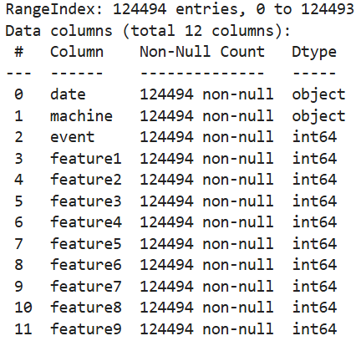
Data Exploration
Data ranging from 01 January 2015 until 02 November 2015.
It contains 124494 records with no missing value.
The datatype of “date” is incorrect. We should change it to datetime datatype.
There are 1168 unique machines recorded in dataset.
Feature3 and Feature4 has very large values compared to other features.

Slide 10
Data Exploration
Highly imbalance data. Event class only contribute <1% of all data. (Ratio: 1:1173)
Class | Count | Proportion
0 | 124.388 | 99.92%
1 | 106 | 0.08%

Slide 11
Key Challenge Found
Extreme imbalanced target variable. Event occurrence is very rare.
False negative are costly to minimize unplanned downtime.
False positive must also be controlled to reduce unnecessary actions.
Standard accuracy metrics are misleading.

Slide 12
03
Feature Engineering

Slide 13
Date Feature Extraction
Raw Date | Day of Week | Day of Month | Month
01-01-2015 | 3 | 1 | 1
03-01-2015 | 5 | 3 | 1
… | … | … | …
The raw date field was transformed into time-based features.
Allows the model to capture temporal patterns in machine behavior.

Slide 14
04
Data Preparation

Slide 15
Train Test Split
Dataset is splitted with ratio 80%:20%.
I use stratification to ensure similar event rate/distribution between train set and test set.
Stratification is used because events is so rare. Pure random split could result in:
Too few event cases (probably even 0 event case)
An unrepresentative test set

Slide 16
Isolation Forest
Machine events are rare and unusual compared to normal machine behavior
Isolation Forest helps detect abnormal patterns. It provides anomaly score indicating how unusual a record on given day. Its score is incorporated to other features.
Day of Week | Feature 1 | … | IF Score
3 | 7 | … | -0.28
5 | 0 | … | -0.31
… | … | … | …

Slide 17
05
Modeling

Slide 18
Overview
Tree-based algorithms (XGBoost and Random Forest) is selected as the classifiers because:
The problem involves complex, non-linear relationship between machine feature, date, anomaly score, and events.
Machine events are very rare, requiring models that could handle extreme imbalance dataset.
XGBoost and Random Forest has been acknowledged as the best classifier for tabular dataset.

Slide 19
Grid Search CV
Grid Search CV is being employed with the following grid parameters:
XGBoost
Random Forest
Parameter | Value
n_estimators | [100, 200, 300]
max_depth | [10, 15, 20]
learning_rate | [0.01, 0.1]
subsample | [0.8, 1.0]
Parameter | Value
n_estimators | [200, 300]
max_depth | [10, 15, 20]
min_samples_split | [2, 5]
min_samples_leaf | [2, 4]
I use Stratified K-Fold CV with K=5

Slide 20
Model Parameter
Tree-based classifier is equipped with cost-sensitive learning to accommodate extreme imbalance classification.
XGBoost
Random Forest
Parameter | Value
scale_pos_weight | 1170
n_estimators | 200
max_depth | 15
learning_rate | 0.1
subsample | 0.8
Parameter | Value
class_weight | {0: 1, 1: 1170}
n_estimators | 200
max_depth | 20
min_samples_split | 5
min_samples_leaf | 2

Slide 21
Metrics and Model Selection
The target variable is highly imbalanced, so common metrics like accuracy and ROC-AUC is misleading.
Average Precision is use for Grid Search CV. It summarize the Precision-Recall curve. It focused on:
How many predicted events are actually correct (precision)
How many true events are successfully detected (recall)
Best score of Grid Search CV:
Random Forest: 0.0755
XGBoost: 0.0808 ⇒ Chosen as best model

Slide 22
06
Evaluation

Slide 23
Threshold Adjustment
Model outputs a probability of machine event, not a final decision.
The default threshold 0.5 assumes balanced class and equal error costs. In this problem, machine event are rare.
Different threshold are evaluated using F1-score to select the best threshold.
Selected threshold for XGBoost: 0.0220

Slide 24
Classification Report on Test Set
 | Precision | Recall | F1-score | Support
No Event | 1.0 | 1.0 | 1.0 | 24878
Event | 0.16 | 0.24 | 0.19 | 21

Slide 25
Confusion Matrix on Test Set
 | Predicted No Event | Predicted Event
Actual No Event | 24851 | 27
Actual Event | 16 | 5

Slide 26
07
Feature Importance

Slide 27
Feature Importance
Feature | Importance
feature6 | 0.2304
feature7 | 0.1231
feature1 | 0.1157
feature8 | 0.1038
day_of_week | 0.0645
iso_score | 0.0629
month | 0.0566

Slide 28
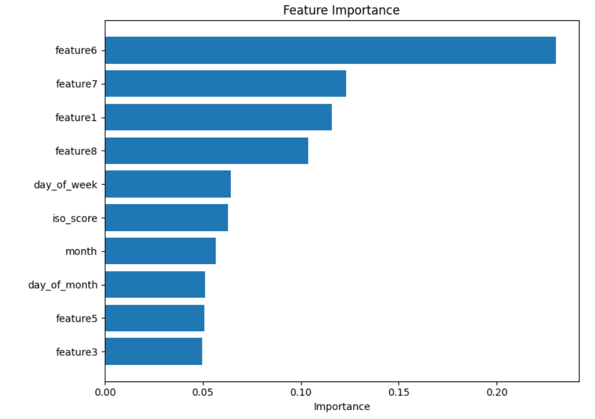
Feature Importance

Slide 29
Summary
Objective: binary classification problem with extreme class imbalance (~1:1173)
Feature engineered temporal features from “date” field and incorporated Isolation forest anomaly score as new feature. This additional features is proven to have significance importance for the model.
Trained cost-sensitive tree-based model (XGBoost and Random Forest) with hyperparameter tuning and grid search.
The model achieves Average Precision value of 0.0808, it is much better compared to random baseline: 1/1173 = 0.00085.
Optimized the decision threshold to control False Positive and False Negative appropriately.

Slide 30
Thank you!
APP Assessment Test for Data Scientist Position
Ekky Rino Fajar Sakti
085857755464 ┃ekky.rino@gmail.com

Slide 31
Questions

Slide 32
Questions and Answers
What type of the Predictive Model you need to build and what are the important independent
features need to chose in model building?
The task requires building a supervised binary classification model to predict the probability of rare machine events. Tree-based model is used since this task is extreme imbalance dataset problem and has non-linear relationship among the data. Tree-based model ( XGBoost and Random Forest) is beneficial in this case because they equipped with cost-sensitive learning.
The model uses machine telemetry features, time-based features extracted from the date field, and anomaly score from Isolation Forest to highlight anomaly behaviour.

Slide 33
Questions and Answers
2. If the business unit decided to go ahead with this project, then concisely and in priority order list what model improvements should be explored?
Enhance temporal feature extraction. Use richer time-based features (lagged signals, or rolling window) to better capture degradation pattern.
Improve anomaly detection integration. Perform hyperparameter tuning for Isolation Forest. Use multiple Isolation Forest for additional features.

Slide 34
Questions and Answers
3. What are your thoughts about the BU’s misrepresentation concerns and their plans for
detecting misrepresentation? How would you go about solving the BU’s misrepresentation concerns?
The BU’s misrepresentation concerns are valid because model is not always perfect, especially in this challenging task. We could minimize the misrepresentation by:
improving data collection guidelines (SOP), (for example calibrating the sensor regularly)
Continuously refine detection logic
Continously monitoring model performance and data distribution to avoid performance degrades over time.

Slide 35
Questions and Answers
4. If the BU was to work with the analytics team; how should the project be managed?
The project should be managed in a phased, starting from defining business objectives (example: acceptable false alarm rate), defining operational constraints, data collection, data validation, prototyping, evaluation, and pilot deployment. After deployment, regular monitoring to review performance, data quality, and business impact are also required.

